Slide 1
Title of the Presentation in Title Case – Option 1
Presenting Author, Author2, Author3
Author’s Institution
Company logo here
Company logo here
Author from Other Institution, Another Author
Other Institution

Slide 2
Title of the Presentation in Title Case – Option 2
Presenting Author, Author2, Author3
Author’s Institution
Company logo here
Company logo here
Author from Other Institution, Another Author
Other Institution

Slide 3
Distill your work into four key items that the audience can learn.
Phrase active learning objectives, starting each one with a verb.
Ensure the objectives are measurable.
Find more guidance on phrasing learning objectives on the AIA website.

Slide 4
Outline
Tips for Good Presentations
Use your time wisely.
If you include an outline, make it descriptive.
Do not try to fit your entire project into a short presentation.
Give ample time to your introduction (the “what”) and conclusion (the “so what”).
Let your audience know where to go for more information.
Tips for Good Presentations
Tips for Good Slides
Tips for Good Graphics
Use Red Boxes to Emphasize Key Points
Team Members

Slide 5
Tips for Good Slides
Keep the amount of text on slides minimal.
Use bullet points instead of large blocks of text.
Visually emphasize your key points.
Use at least 30pt font size to make your slides readable from a distance.
Use visual aids to support your points.
Tell a story. Take your audience through the main points of your motivation, methods, and findings.

Slide 6
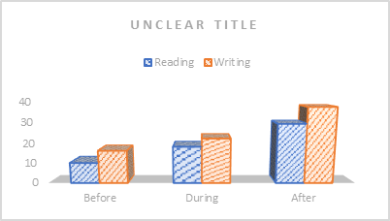
Tips for Good Graphics
Use the template fonts (Montserrat and Montserrat SemiBold) and styles for consistency.
The default colors in this template are red (214, 33, 49) and blue (4, 11, 255).
The default text color is dark blue (14, 40, 65).
Avoid pixelated images.
A well-made, easy to read figure.
A badly made graph that is hard to read.

Slide 7
Use Red Boxes to Emphasize Key Points
Give your complex figures the space they deserve.
Let the image speak for itself and keep text to the most important points.
Use this opportunity to interact with your slides. (Point, describe, interpret.)

Slide 8
Team Members
Many publications are a team effort. A slide with all team members is a great way to acknowledge their work. You can include roles, institutions, or contact information.

Slide 9
Conclusion
Write the key take-away message from your presentation here. (Option 1)
Contact
Name
Email
Website
Socials
Company logo here
Company logo here

Slide 10
Conclusion
Write the key take-away message from your presentation here. (Option 2)
Contact
Name
Email
Website
Socials
Company logo here
Company logo here

